Slide 1
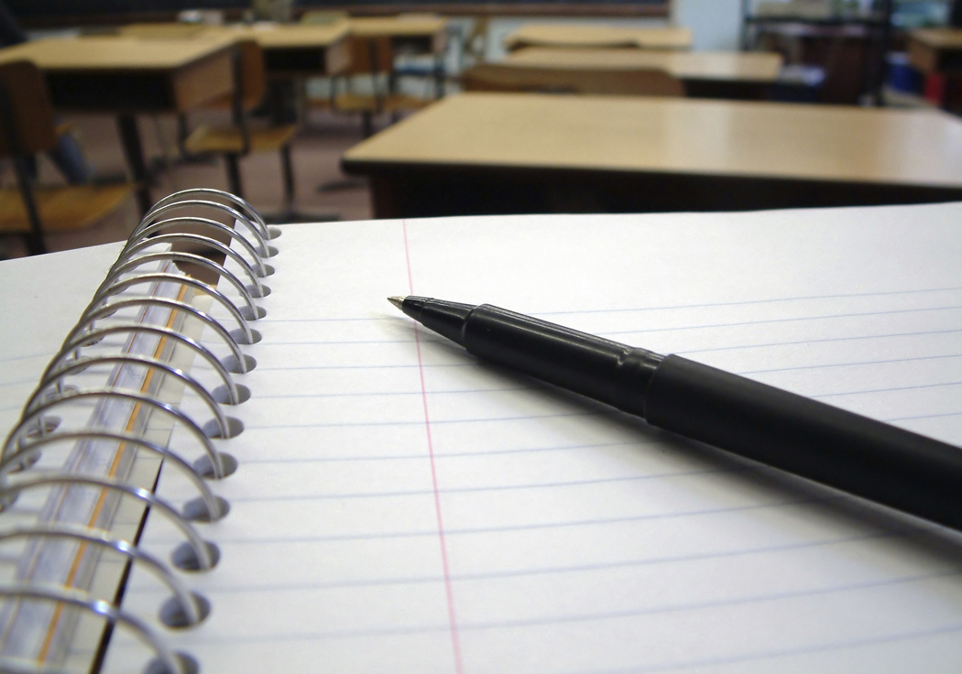
The Five Types of Plagiarism
Are You Stealing Intellectual Property?
Adapted from Instructor Theresa Ireton’s in-class presentation
*

Slide 2
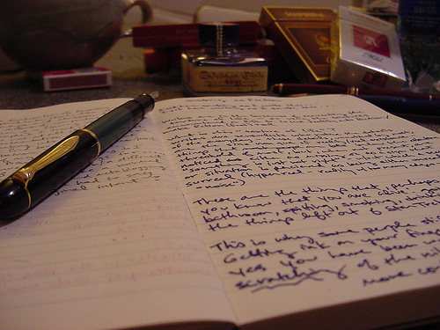
What is Plagiarism?
Presenting another’s original thoughts or ideas as your own – this includes paraphrasing or summarizing without a citation
Using another’s exact words without proper citation
*

Slide 3
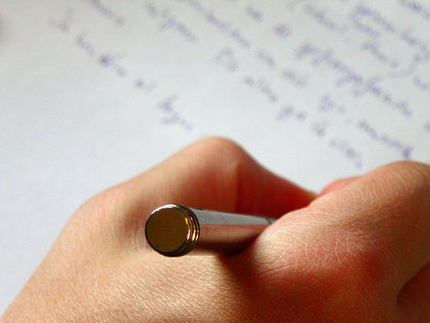
Strategies to Avoid Plagiarism
Isolate the reasons why plagiarism occurs
Identify the different types of plagiarism
Integrate plagiarism prevention
*

Slide 4
At Bishop Hartley
We teach what plagiarism is and how to avoid it.
We use MLA citations to correctly cite sources. Some disciplines may introduce other citation styles.
We use turnitin.com at the rough draft stage to show students what material requires citations.
*

Slide 5
Types of Plagiarism
*

Slide 6
Unintentional Plagiarism
Paraphrasing poorly: changing a few words without changing the sentence structure of the original, or changing the sentence structure but not the words.
Quoting poorly: putting quotation marks around part of a quotation but not around all of it or putting quotation marks around a passage that is partly paraphrased and partly quoted.
Citing poorly: omitting an occasional citation or citing inaccurately.
MLA handbook for writers of research papers. (7th ed.). The Modern Language Association of America. New York: 2009. Print.
*

Slide 7
Intentional Plagiarism
Passing off as one’s own pre-written papers from the Internet or other sources.
Copying an essay or article from the Internet, on-line source, or electronic database without quoting or giving credit.
Cutting and pasting from more than one source to create a paper without quoting or giving credit.
Borrowing words or ideas from other students or sources without giving credit.
MLA handbook for writers of research papers. (7th ed.). The Modern Language Association of America. New York: 2009. Print.
*

Slide 8
Plagiarism Prevention: Be authentic
Develop a topic based on previously written material but write something new and original
Rely on opinions of experts on a topic but improve upon those opinions
Give credit to researchers while making your own contribution
Follow a standard documentation method such as MLA or APA format
*

Slide 9
The First Type of plagiarism
Plagiarism of Words
The use of another’s exact words without citing the author
Incorrect
Plagiarism is the reproduction of someone else’s words, ideas or findings and presenting them as one’s own without proper acknowledgement.
Correct
Plagiarism is the “reproduction of someone else’s words, ideas or findings and presenting them as one’s own without proper acknowledgement” (Undergraduate Course Handbook: 2008, p.24 [please note: this reference is from the original Power Point presentation citing the Centralia College Student Handbook])
*

Slide 10
The Second Type of plagiarism
Plagiarism of Structure
Paraphrasing another’s words by changing sentence construction or word choice with citation
Paraphrasing while maintaining original sentence construction with acknowledging the source
*

Slide 11
The Third Type of plagiarism
Plagiarism of Ideas
Presenting another’s
ideas as your own
without giving the
person credit
Submitting a paper
without citing or
incorrectly citing
another’s ideas
If you did not know
the information, or
have the idea before
you read it
somewhere, it must
be cited.
This includes ideas you may receive from friends and family members who help you.
*

Slide 12
The Fourth Type of plagiarism
Plagiarism of Authorship
Turning in a
replication of
another’s work
Submitting a paper
that you got off the
internet or from a
family member or friend
and presenting
it as your own
*

Slide 13
The Fifth Type of plagiarism
Plagiarism of Self
The use of previous work for a separate assignment
Although these were your original words and thoughts; receiving credit for a previous assignment is considered cheating.
You have not done the work for this assignment.
*

Slide 14
The Bishop Hartley Policy Regarding Plagiarism
The Bishop Hartley policy on plagiarism is part of the larger, more encompassing Academic Integrity Policy. Students and parents are responsible for reading the full policy before signing the Student Handbook Acknowledgement each school year.
The policy is printed on the slides that follow. Parents should be aware that consequences for plagiarism are cumulative over four years and administered by the Dean of Students, Mr. Jacob Matuska. Questions about consequences should be directed to him.
Slides with a double ** are from the Bishop Hartley Student Handbook.

Slide 15
This is the full policy on plagiarism:
The English department at Bishop Hartley High School has adopted the following definition of plagiarism from the article, “What is Plagiarism” (https://www.plagiarism.org/article/whatis-plagiarism, May 18, 2017) that each academic department will adhere to:
According to the Merriam-Webster online dictionary, to "plagiarize" means:
to steal and pass off (the ideas or words of another) as one’s own
to use (another’s production) without crediting the source
to commit literary theft
to present as new and original an idea or product derived from an existing source.
In other words, plagiarism is an act of fraud. It involves both stealing someone else’s work and lying about it afterward.
All students will review this definition of plagiarism in their English classes at the beginning of the school year and learn how to utilize turnitin.com as a resource. Additionally, each faculty member is asked to discuss academic integrity with their students to ensure clarity on the subject.
**

Slide 16
Plagiarism is considered a major violation o fthe academic integrity policy
Major offenses of academic dishonesty are determined to significantly impact a student’s ability to demonstrate mastery of concepts. Major offenses involve a premeditated plan to commit an act of academic dishonesty.
The consequences of plagiarism are on the slides which follow.
**

Slide 17
A first major violation of academic integrity results in the following:
The teacher will discuss the incident with the student and then contact the student’s parents by phone and email.
The Vice Principal of Academics & Student Services, the Dean of Students, and the student’s School Counselor will be notified of the violation.
The student will receive 10 demerits and be assigned to serve one After School Detention.
The student will be required to make up the assignment or assessment or take an alternative assessment. All make-up work will occur during office hours or at a mutually agreed upon time with the teacher to properly evaluate mastery of learning objectives.
Students will be required to pay a proctoring fee of $25.00 to the teacher if extra time outside of office hours is required to make up the work or assessment.
Students will receive a grade no higher than a C for the respective assessment.
Continued next slide
**

Slide 18
Any student involved in athletics, extracurriculars, theatre, and/or house leadership will have the Athletic Director, his or her Coach and/or Club Sponsor notified and will be placed on probation. Any further violations of academic integrity may result in a loss of a percentage of participation.
The student will be referred to the Academic and Discipline Review Committee at the end of the year. The Academic and Discipline Review Committee will review the student’s overall academic performance to determine if the student continues to benefit from our educational program at Bishop Hartley.
**

Slide 19
A second major violation of academic integrity results in the following:
The teacher will discuss the incident with the student and then contact the student’s parents by phone and email.
The Vice Principal of Academics & Student Services, the Dean of Students, and the student’s School Counselor will be notified of the violation.
The student will receive 25 demerits and be assigned to serve two After School Detentions.
The student will be required to make up the assignment or assessment or take an alternative assessment. All make-up work will occur during office hours or at a mutually agreed upon time with the teacher to properly evaluate mastery of learning objectives.
Students will be required to pay a proctoring fee of $25.00 to the teacher if extra time outside of office hours is required to make up the work or assessment.
Students will receive a grade no higher than a C for the respective assessment.
Continued next slide

Slide 20
Any student involved in athletics, extracurriculars, theatre, and/or house leadership will have the Athletic Director, his or her Coach and/or Club Sponsor notified and will be placed on probation. Any further violations of academic integrity may result in a loss of a percentage of participation.
Any student involved in house leadership will be denied the ability to fulfill or run for a school, house, or mentor group captain position for one year.
The student will be referred to the Academic and Discipline Review Committee at the end of the year. The Academic and Discipline Review Committee will review the student’s overall academic performance to determine if the student continues to benefit from our educational program at Bishop Hartley.

Slide 21
A third major violation of academic integrity results in the following:
Upon a student’s third major violation of academic integrity, he or she will be subject to suspension and possible expulsion. An expulsion hearing will take place and alternative consequences may be decided upon by administration.
If the expulsion hearing does not result in an expulsion, the student will be referred to the Academic and Discipline Review Committee at the end of the year. The Academic and Discipline Review Committee will review the student’s overall academic performance to determine if the student continues to benefit from our educational program at Bishop Hartley.

Slide 22
Major violations of academic integrity accumulate over a student’s high school career.
**

Slide 23
To Learn more
Visit
Original Power Point
Plagiarism.org
Take the turnitin.com plagiarism quiz

Slide 24
Original Source for Power Point Presentation (slides with an * are from this presentation)
https://www.google.com/url?client=internal-element-cse&cx=013661968159821514831:xrs9iyct0m4&q=https://www.centralia.edu/resources/docs/plagiarism.pptx&sa=U&ved=2ahUKEwi5s_eS6_3uAhXGZc0KHYIlDfAQFjAAegQIABAB&usg=AOvVaw2wbfWcV7KtOLvd-nQlXISo
The presentation here is adapted from the original as indicated at the beginning of the presentation. The creator of the original Power Point presentation has cited all other sources within the presentation.

